Slide 1
P2P: EHr
Angie Li, MD

Slide 2
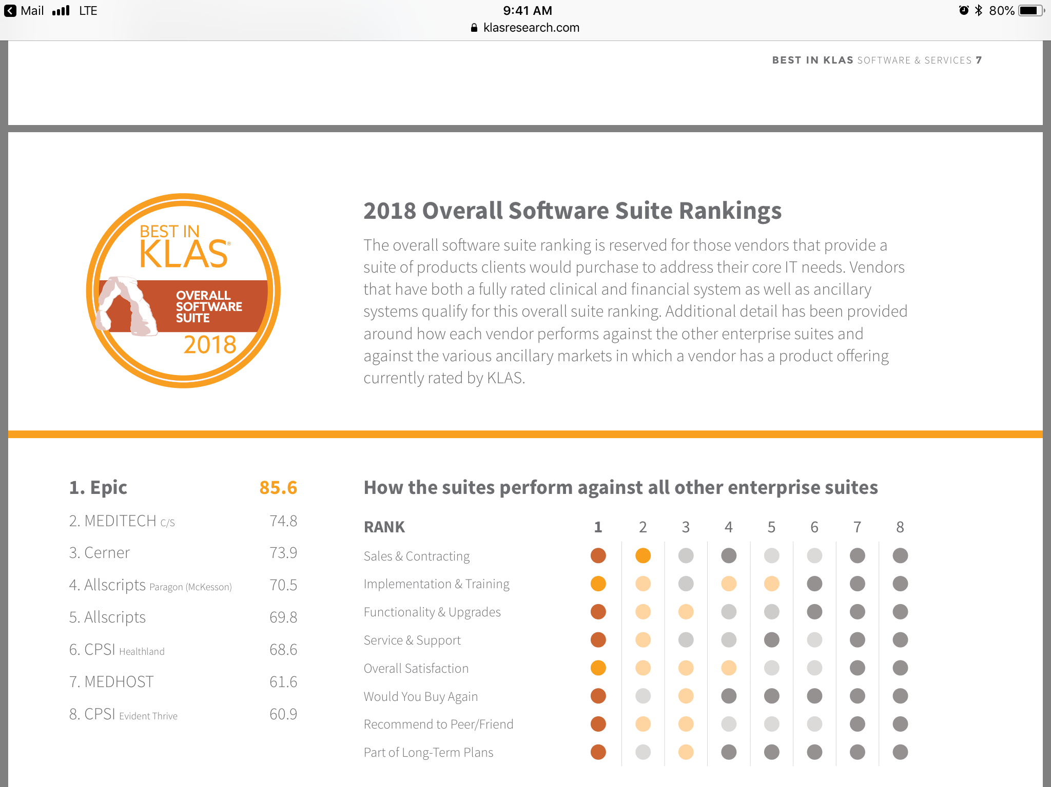
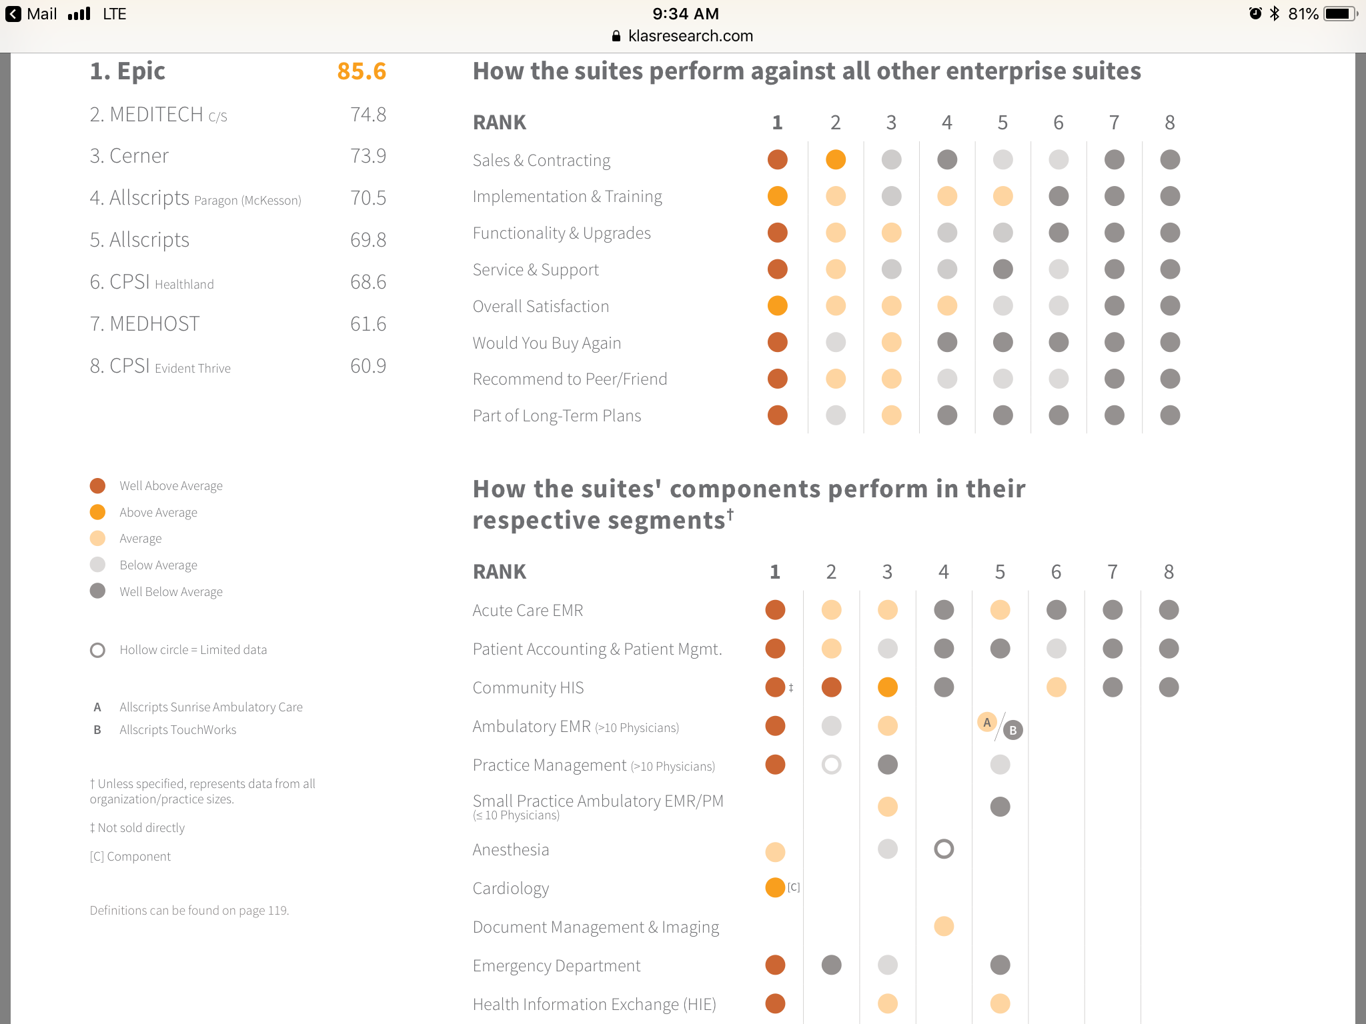

Slide 3
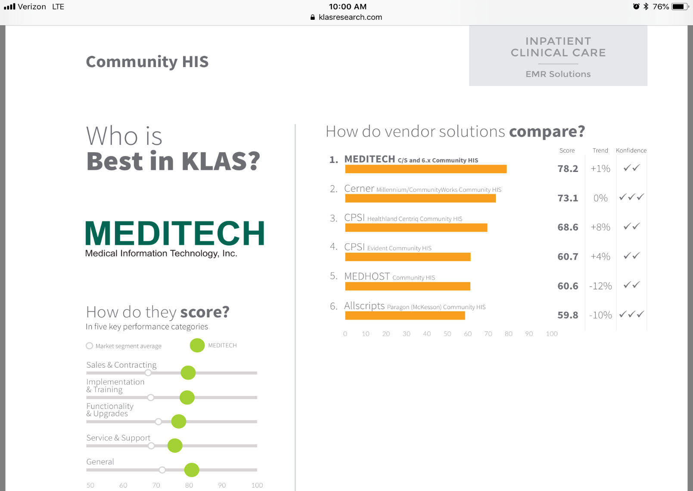
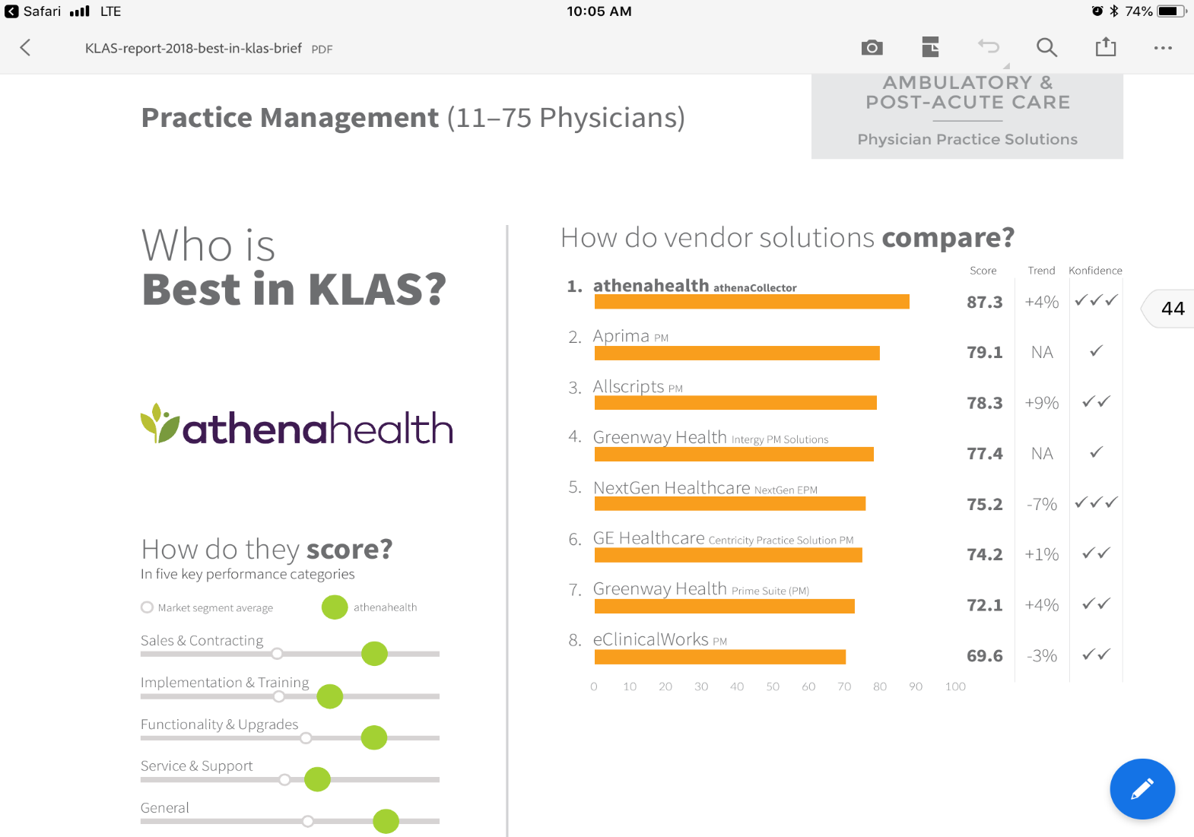

Slide 4
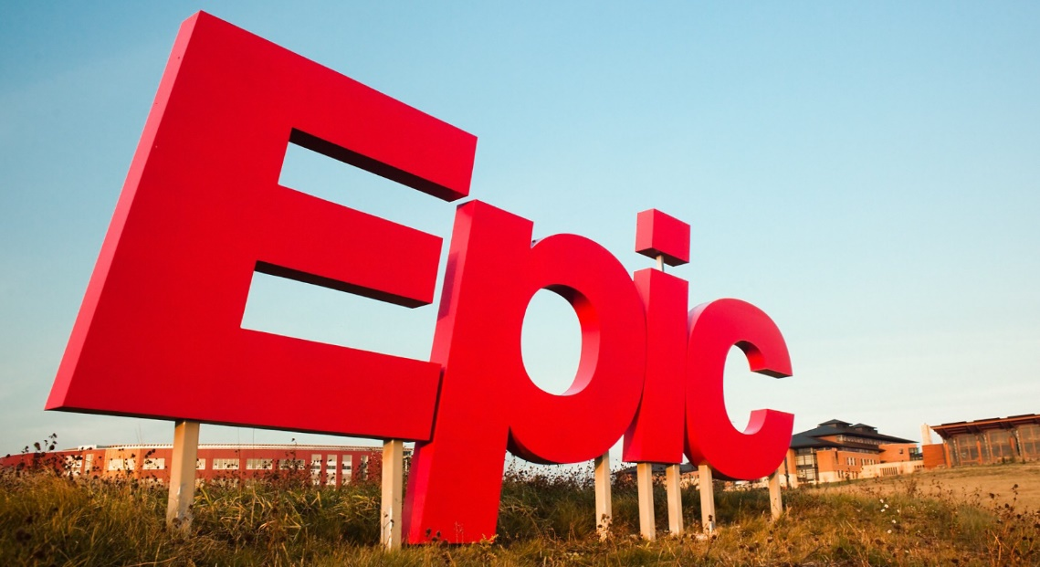
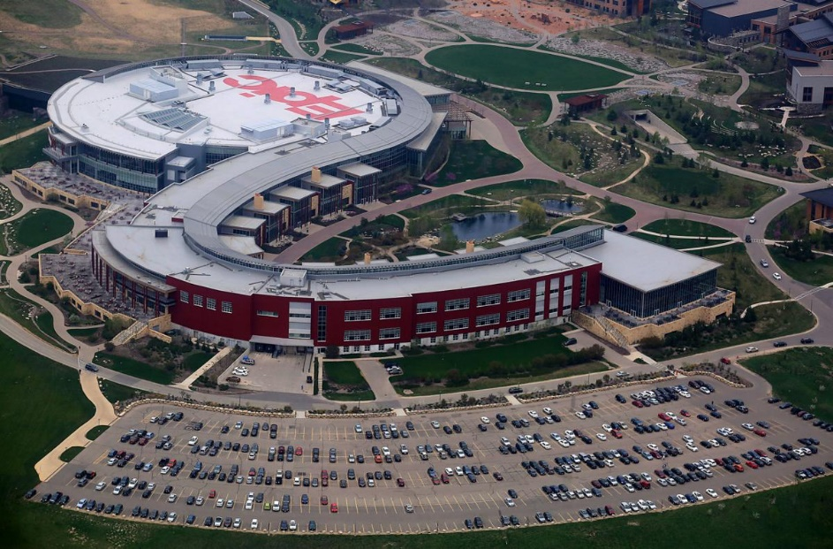
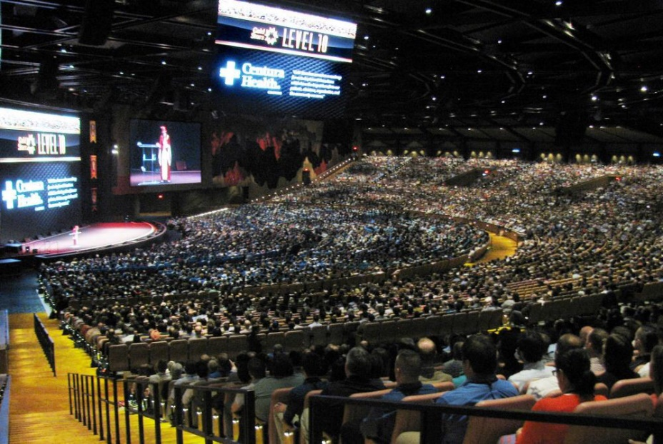
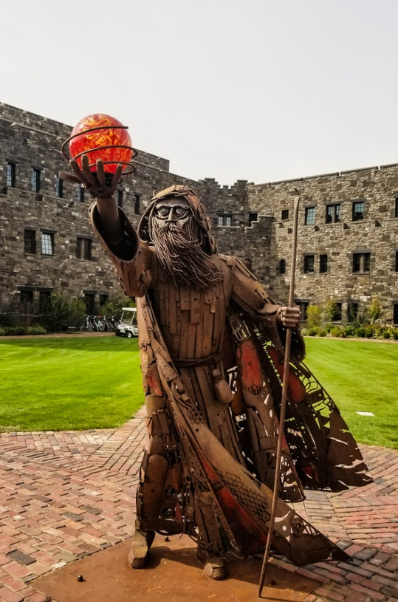
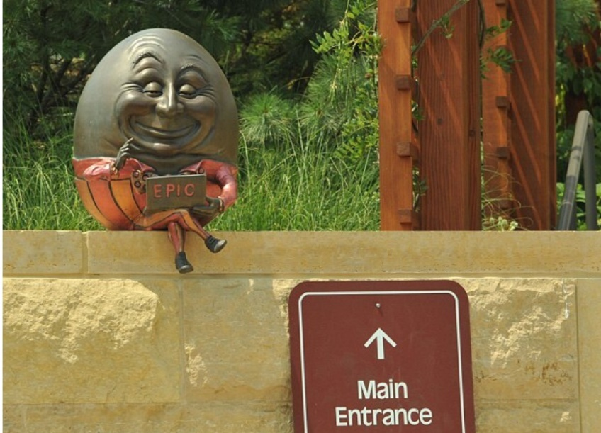
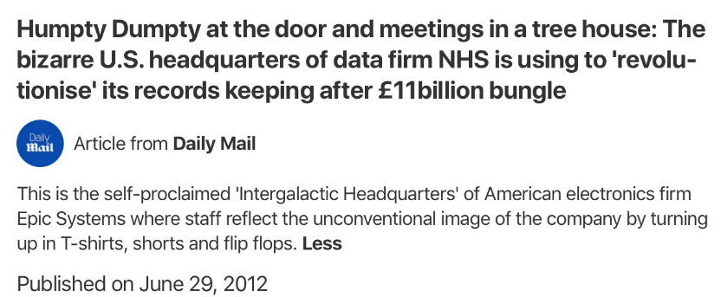
Founded in 1979 by Judith Faulkner
Faulkner was computer science graduate student under future cofounder of BMI department at Harvard
Initially made electronic call schedule system for doctors, then tracked clinical data elements at University of Wisconsin
Base programming language MUMPS, which is also backbone of Meditech, VistA, Allscripts EHRs
As of 2017, approximately 190 million patients worldwide have a record in Epic’s HER
Controversial for interoperability, expense, consumers feeling “trapped” after implementation

Slide 5
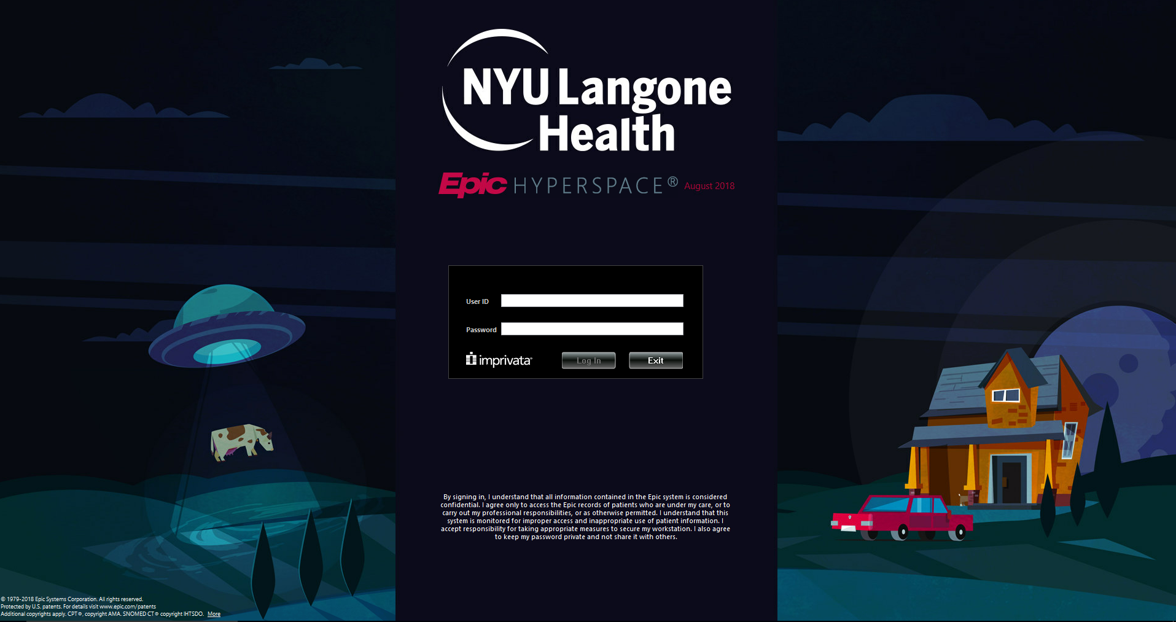

Slide 6
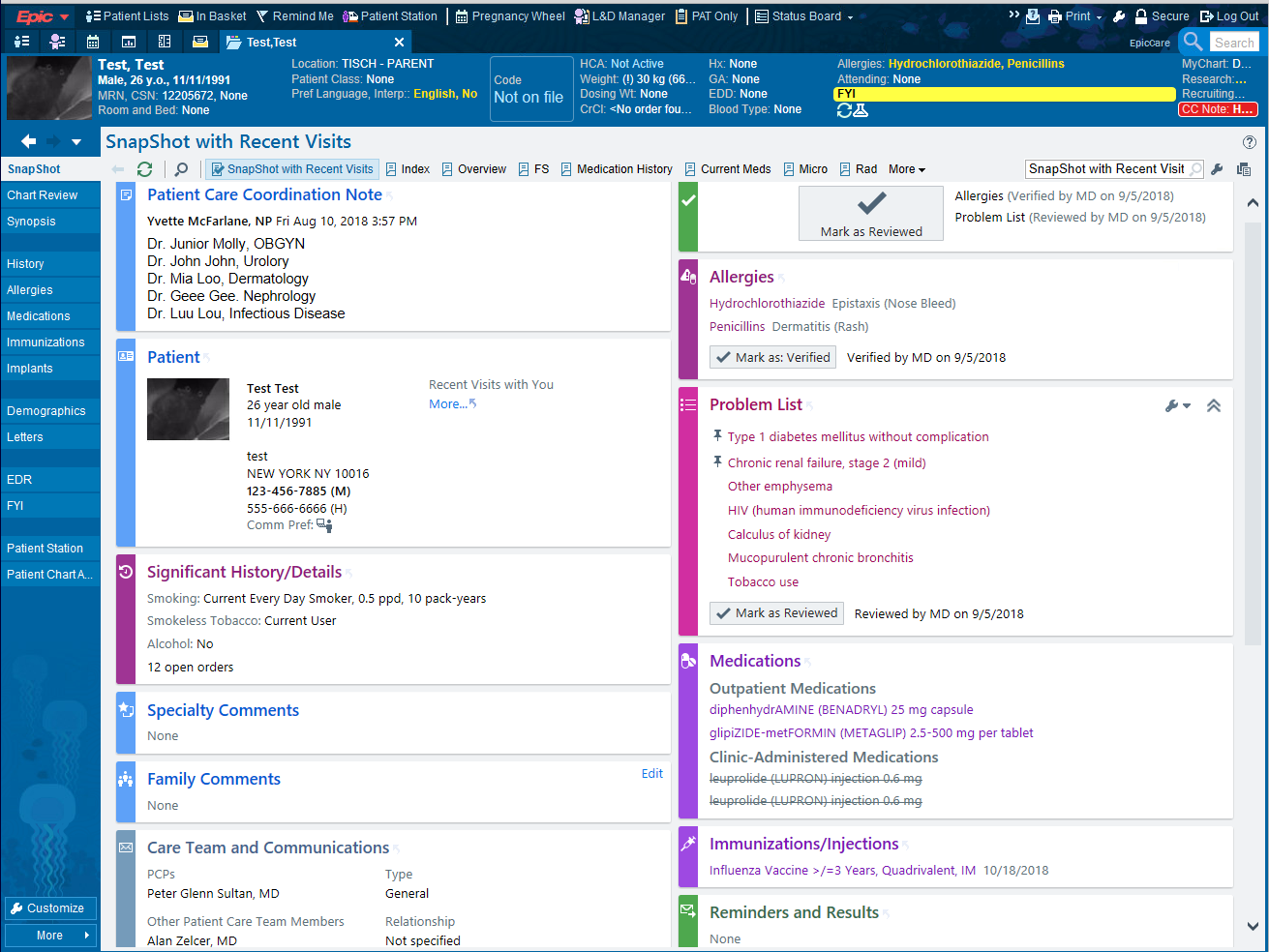

Slide 7
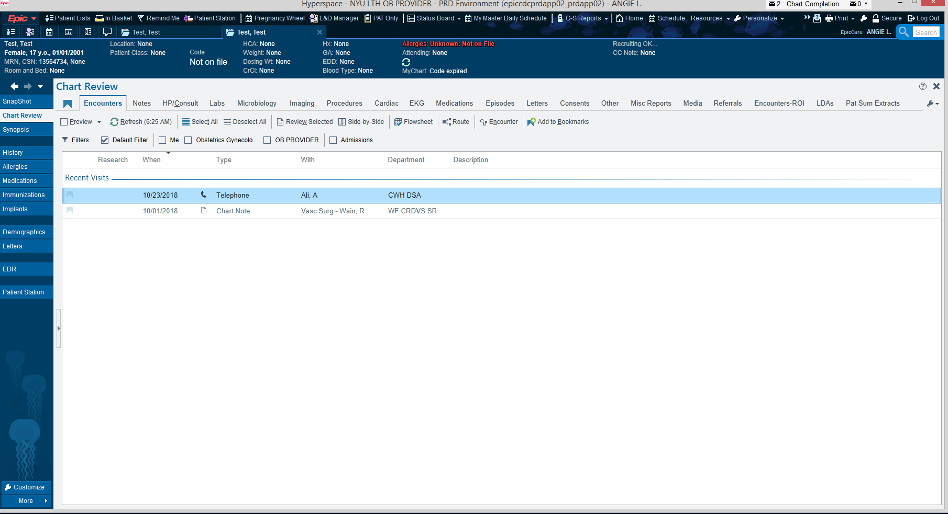

Slide 8
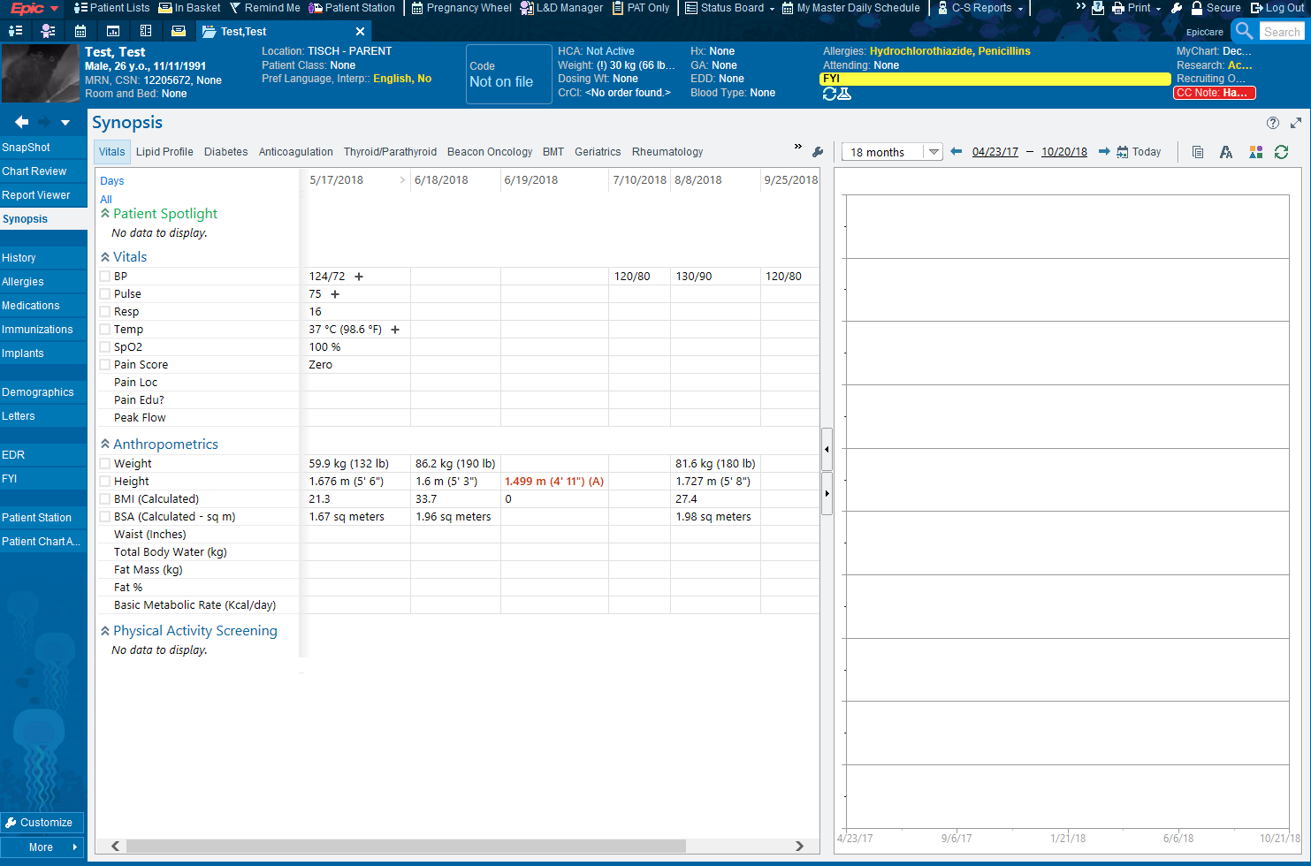

Slide 9
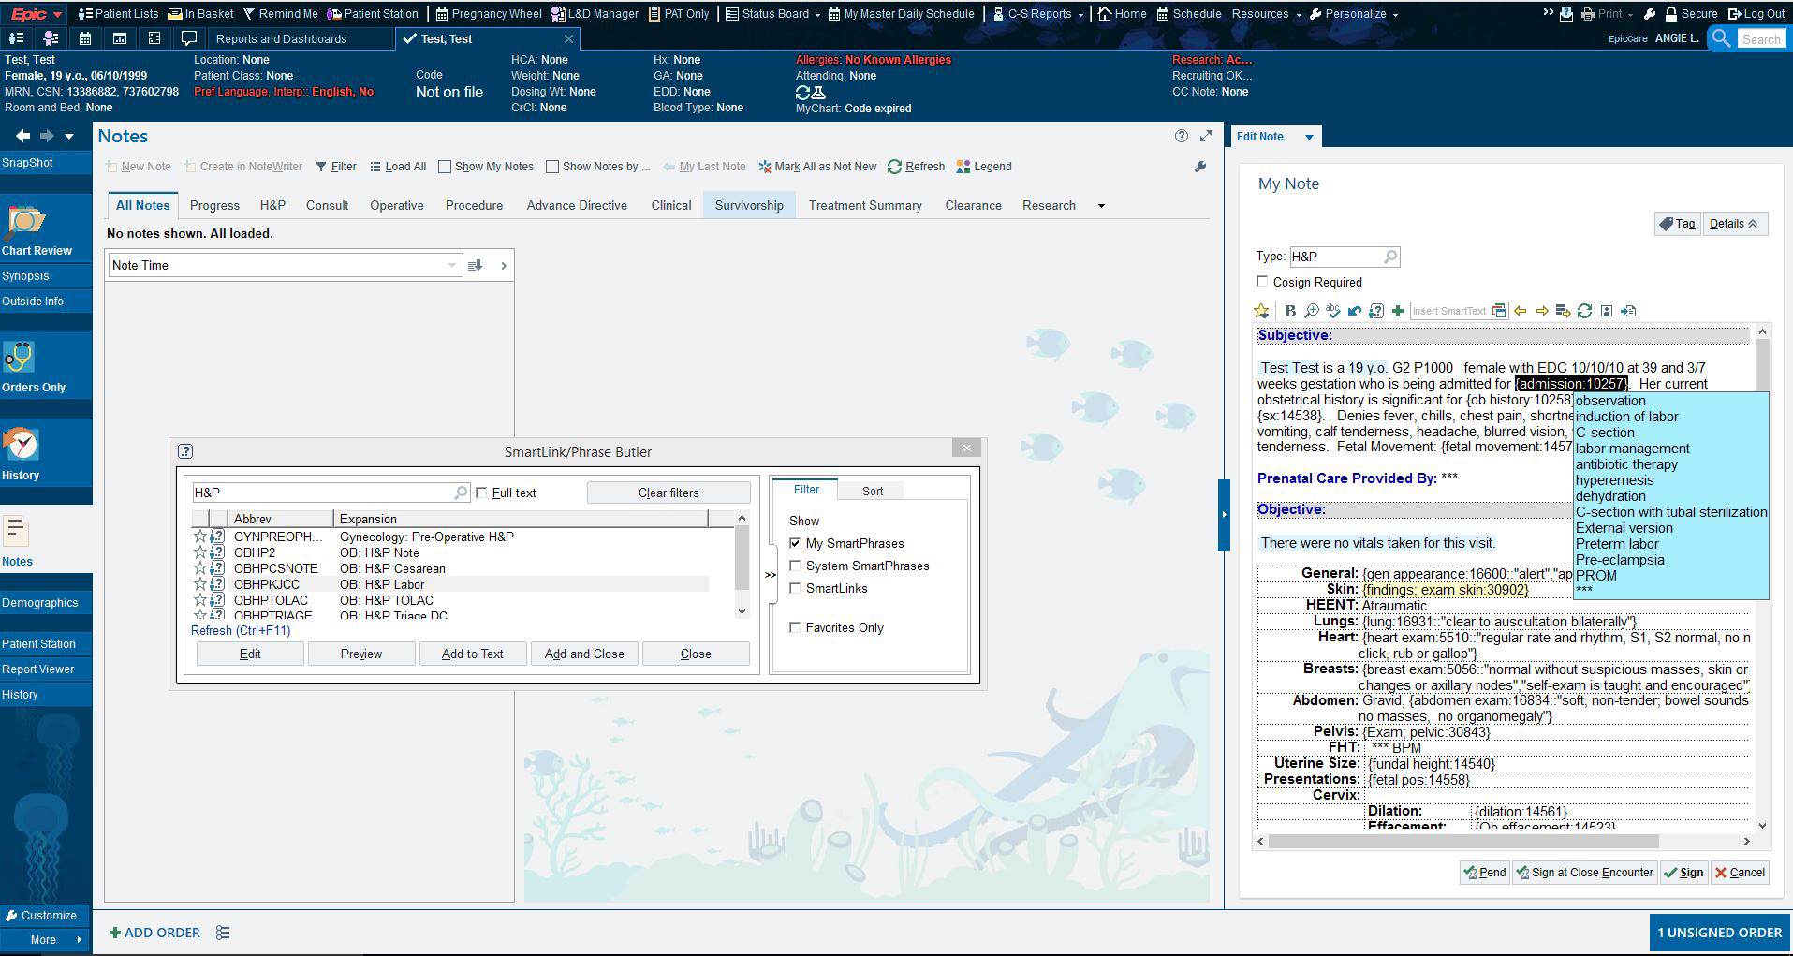

Slide 10
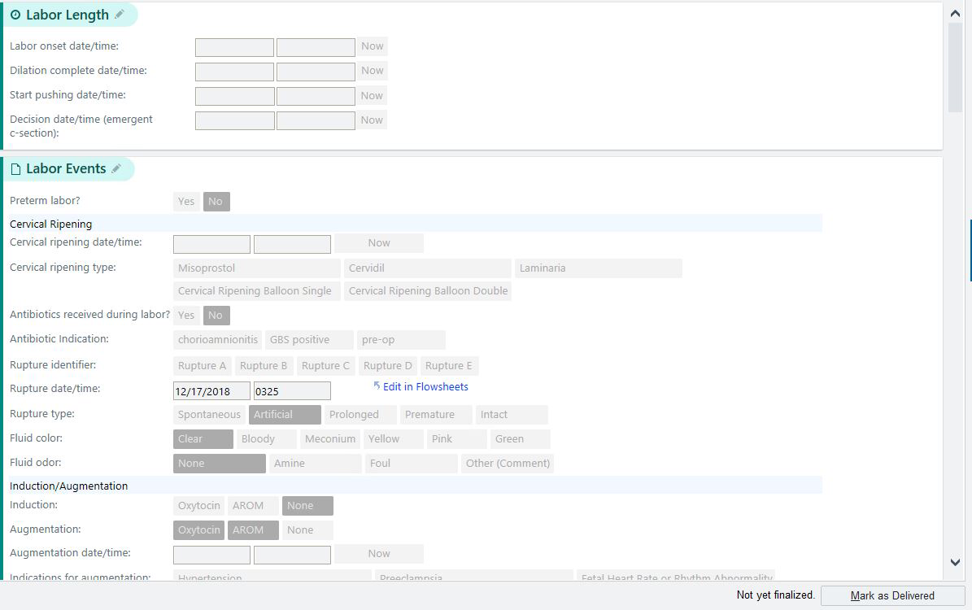

Slide 11
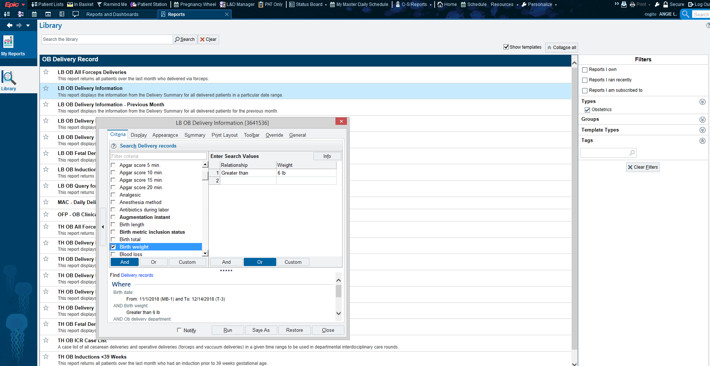

Slide 12
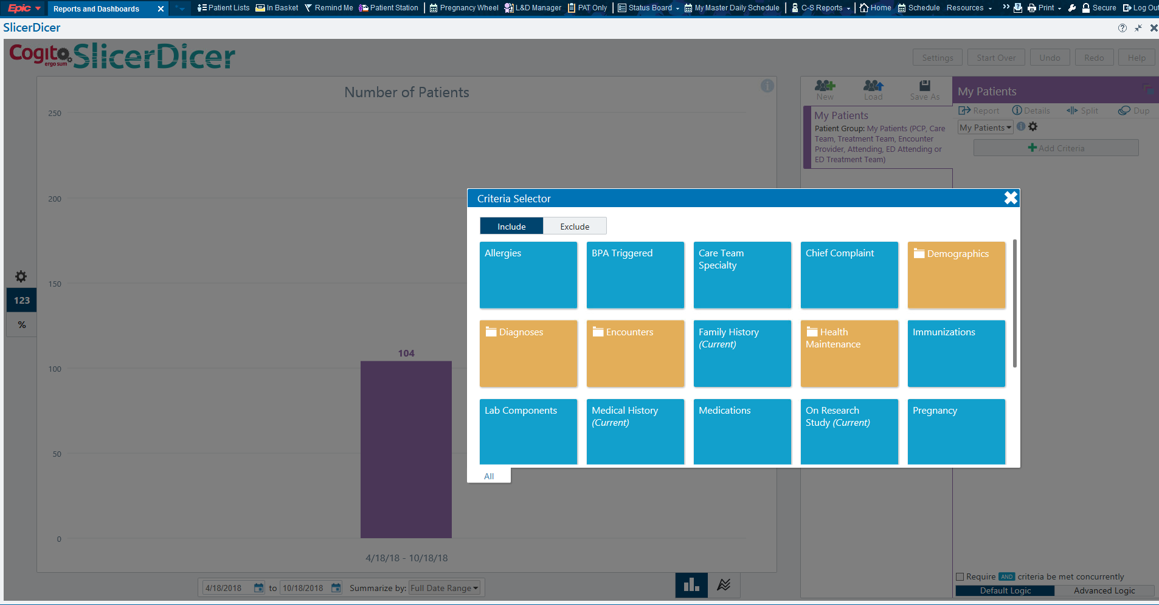

Slide 13
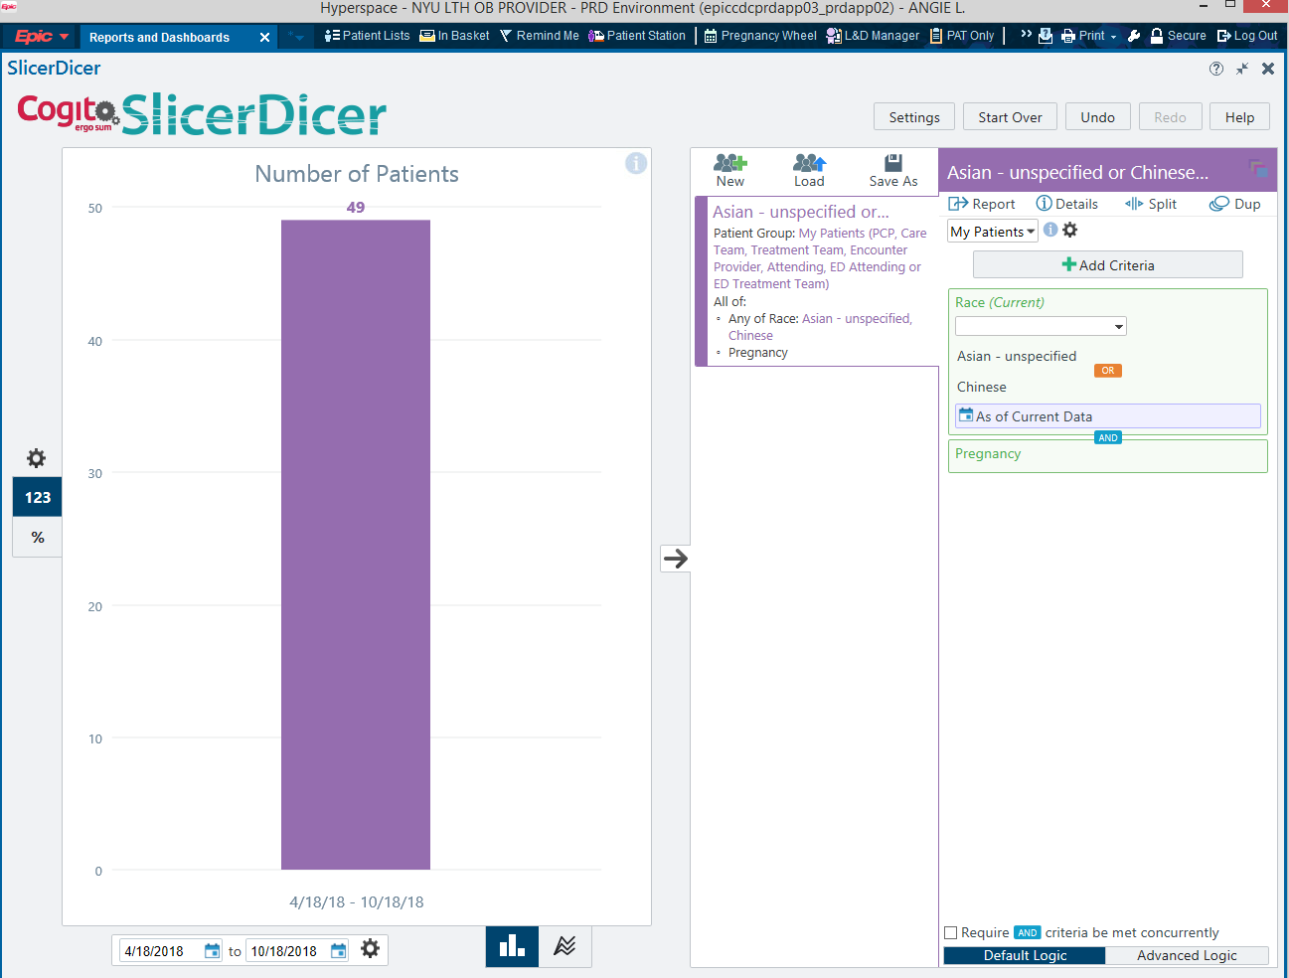

Slide 14
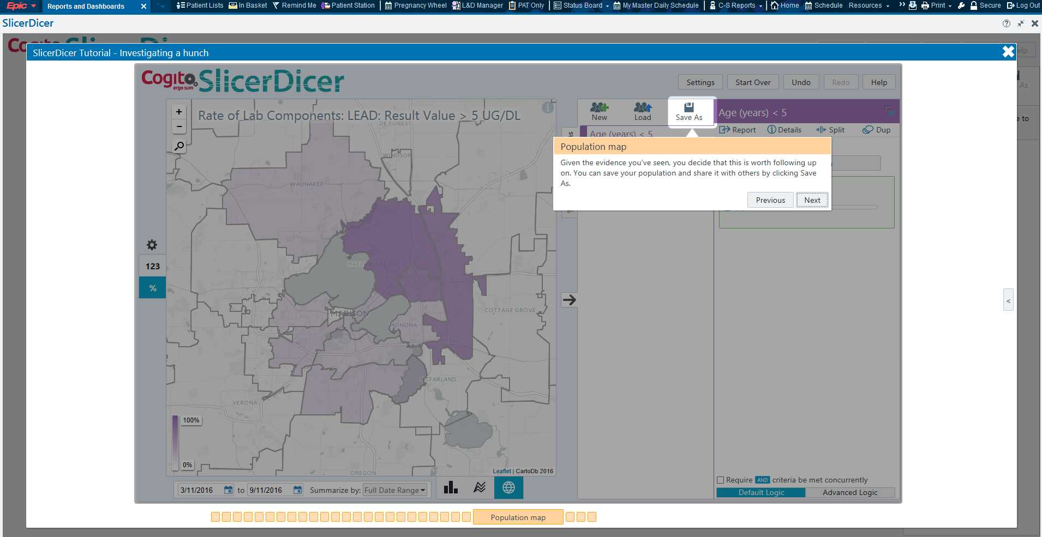

Slide 15
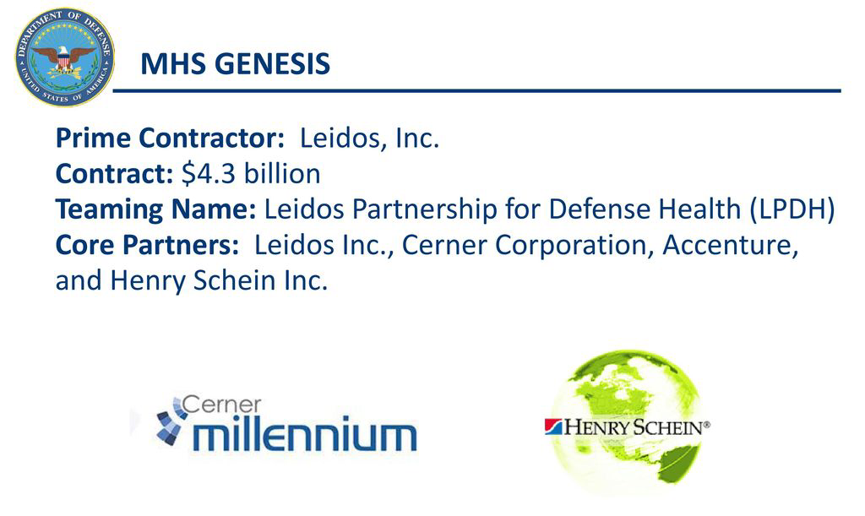
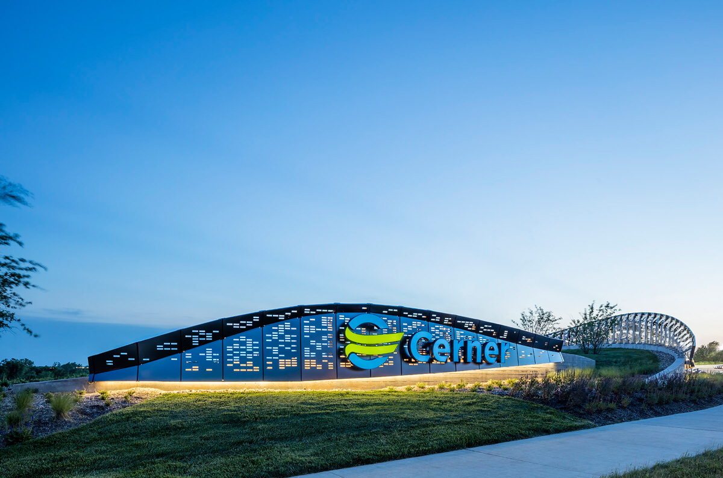
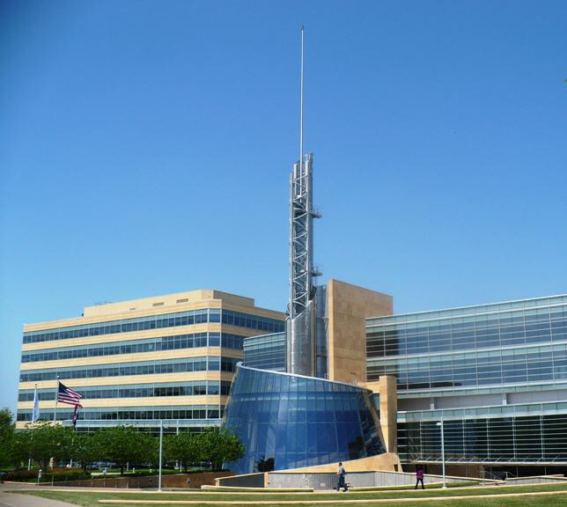
Founded in 1979 by Neal Patterson
In the 1980s, mostly provided PathNet, RadNet software until Cerner Millenium was introduced in 1997
CCL (Cerner Command Language, now Discern Explorer) is similar to SQL and can be used to obtain clinical data from an Oracle database
Cerner Open Developer Experience: allows developers to submit SMART on FHIR apps

Slide 16
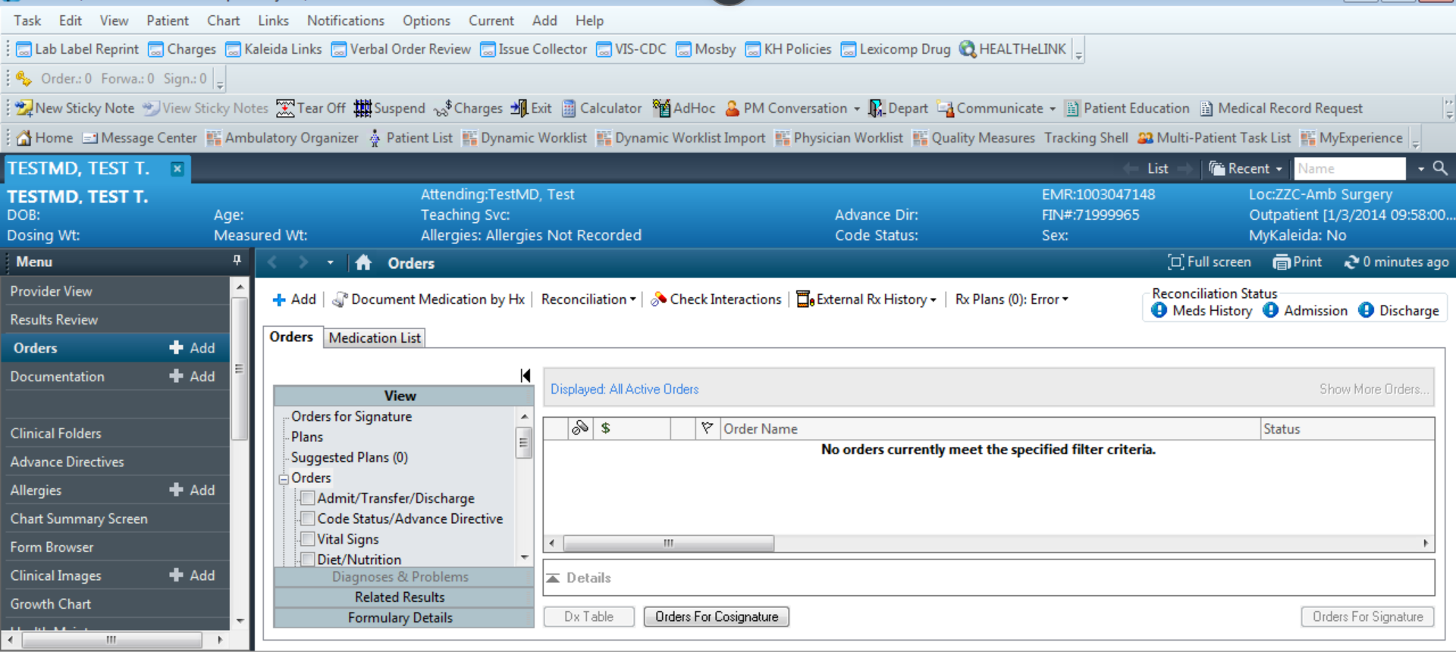

Slide 17
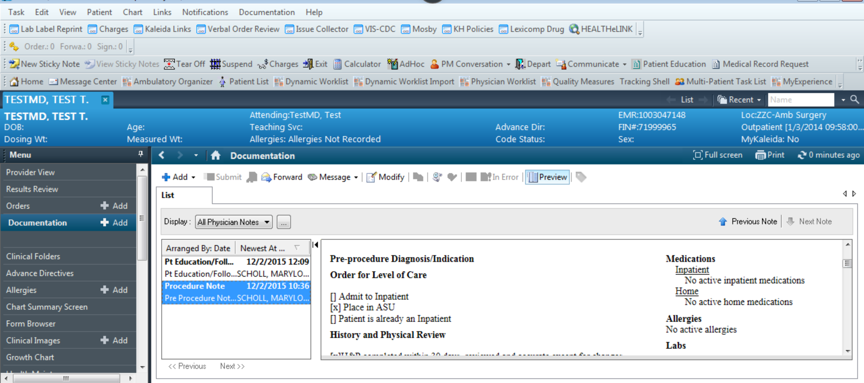

Slide 18
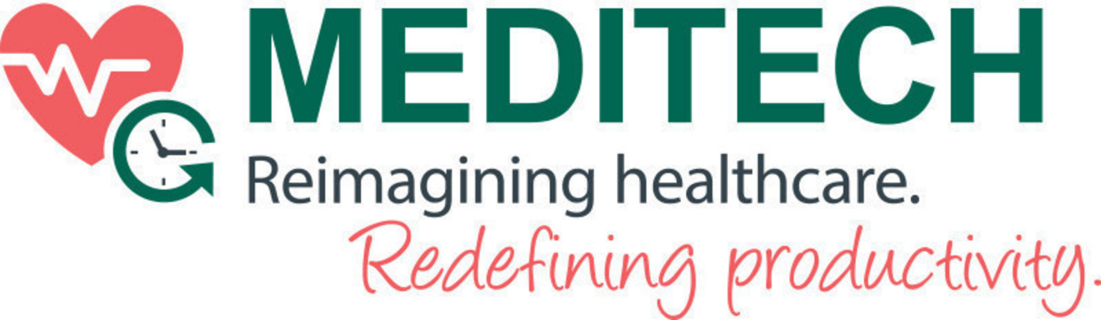
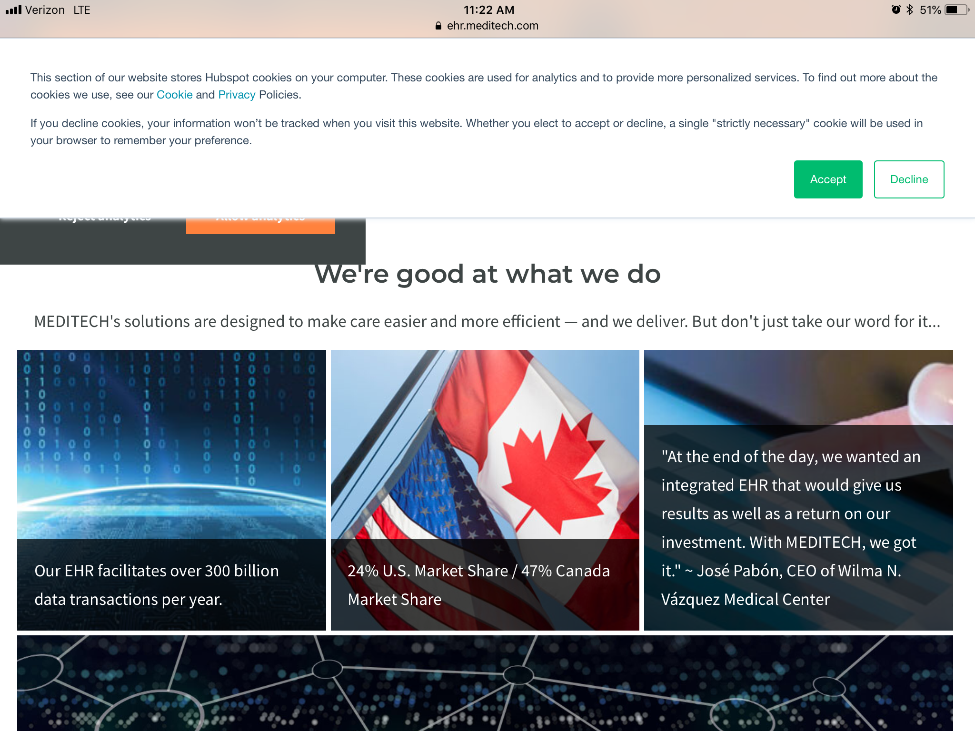
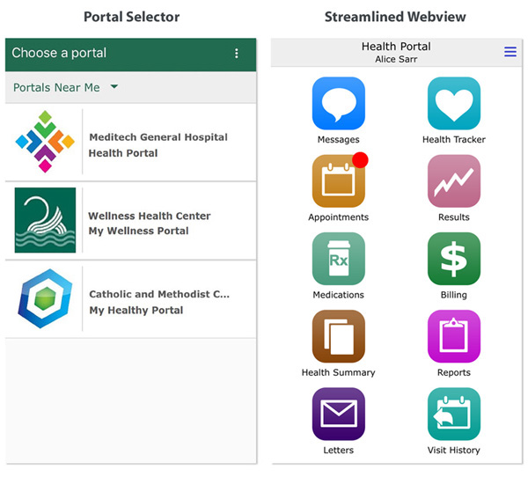
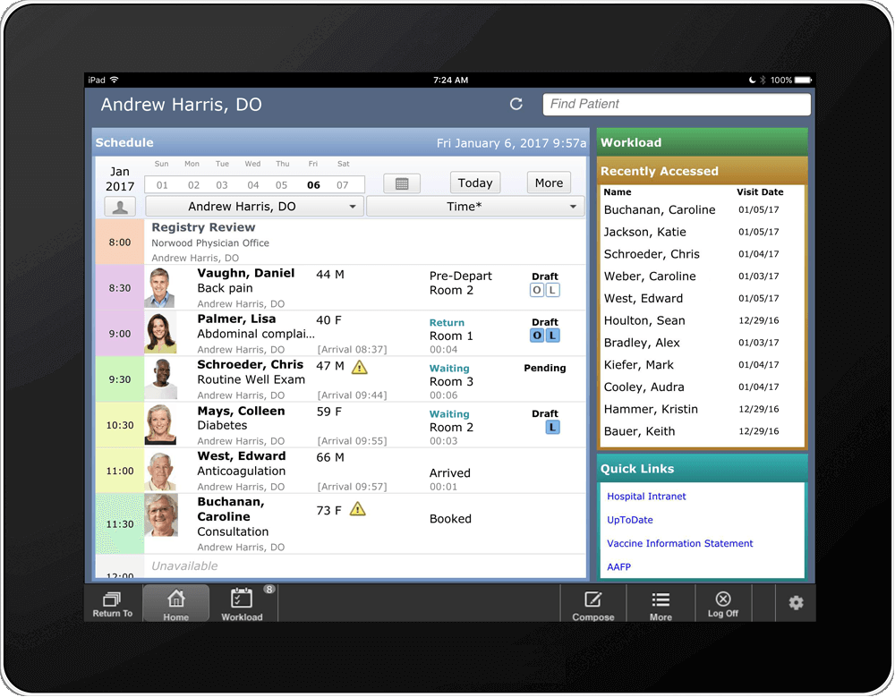
Founded in 1969 by Neil Pappalardo, one of the original developers of MUMPS
Recent falling marketshare
Working on implementations of ambulatory cloud-based EHR

Slide 19
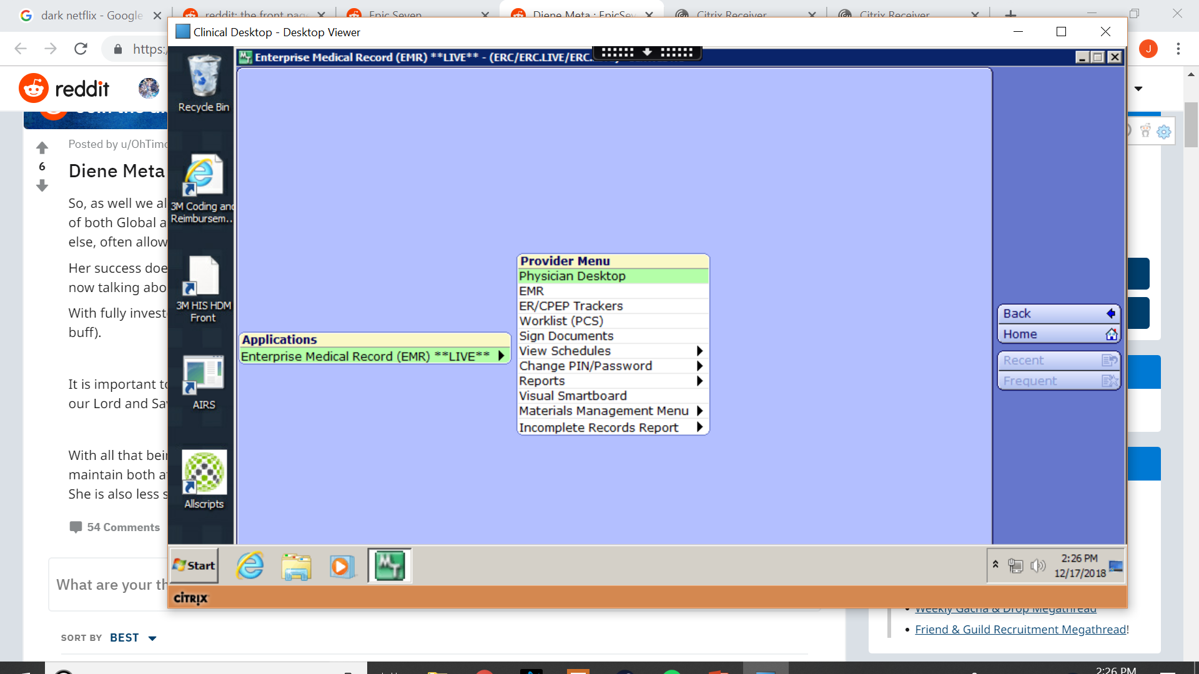
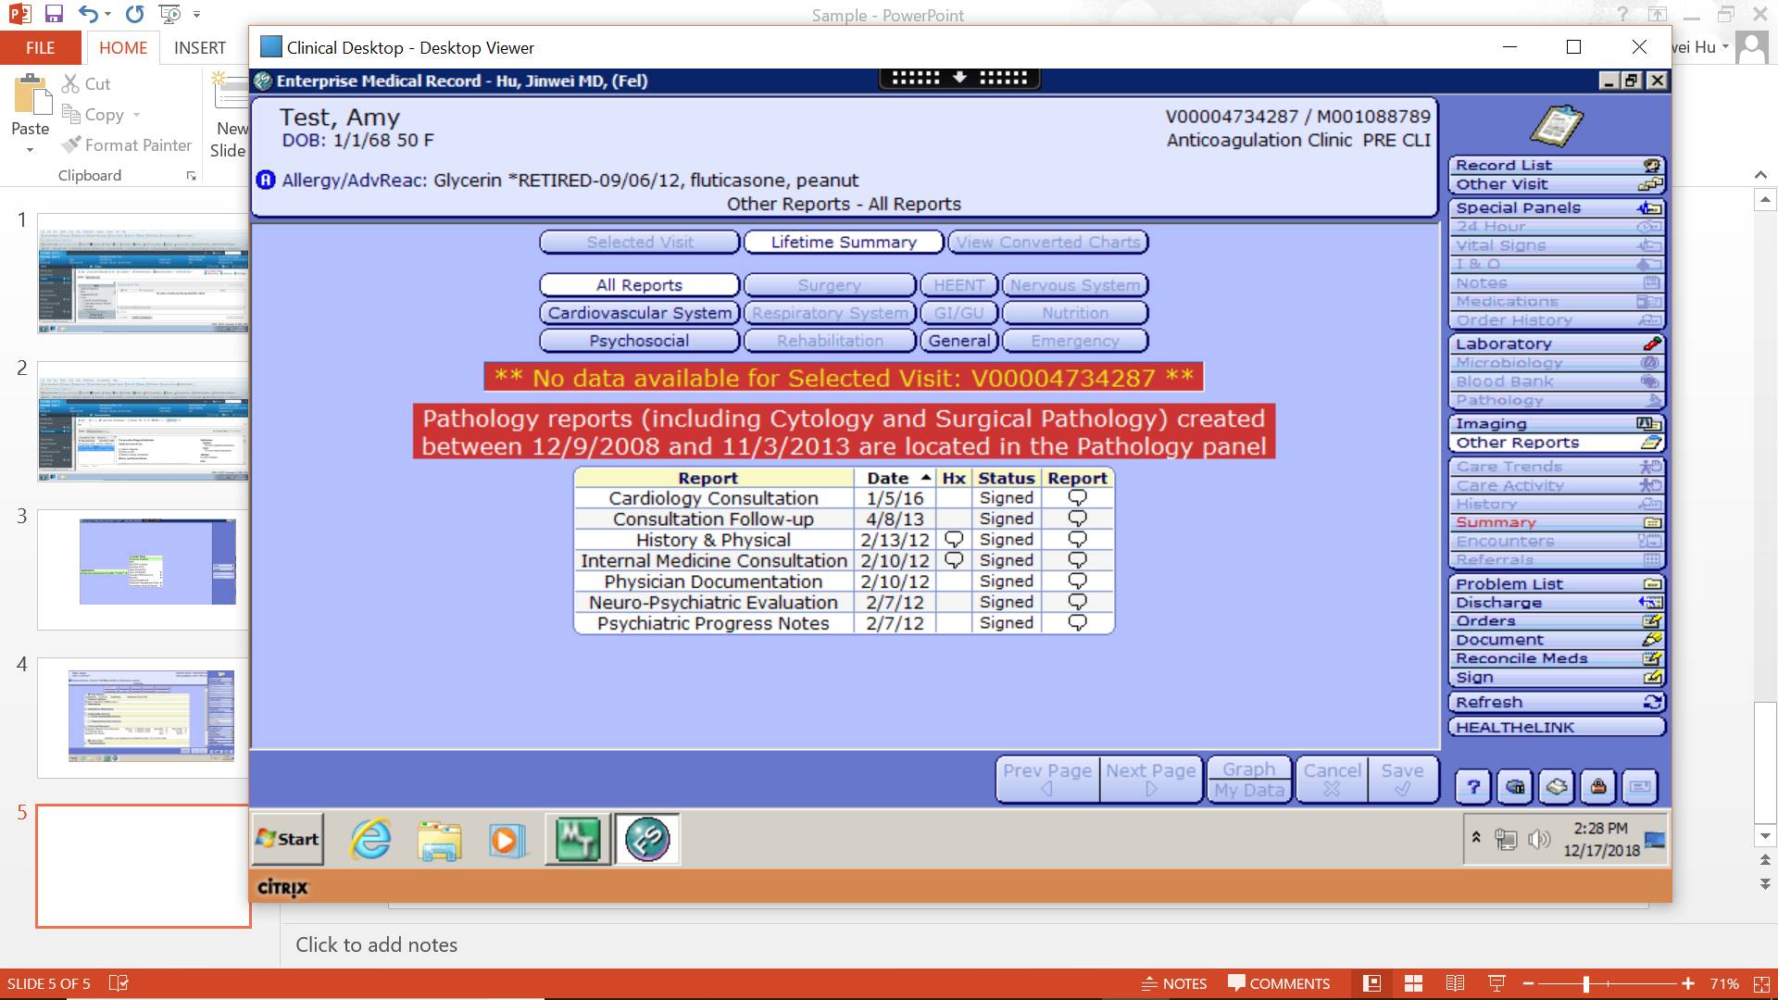

Slide 20
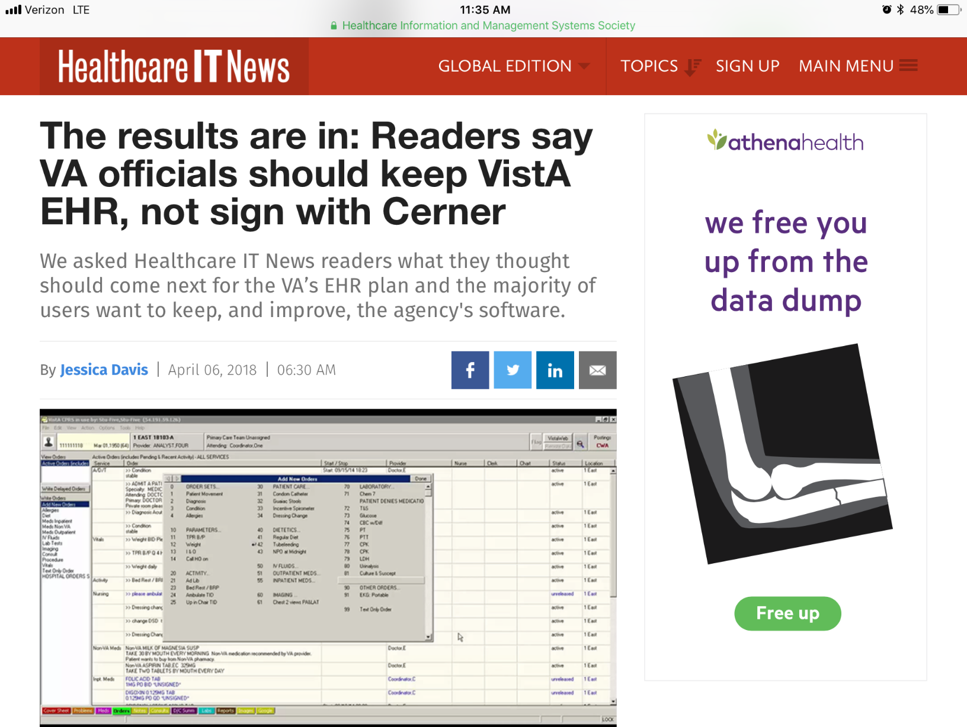
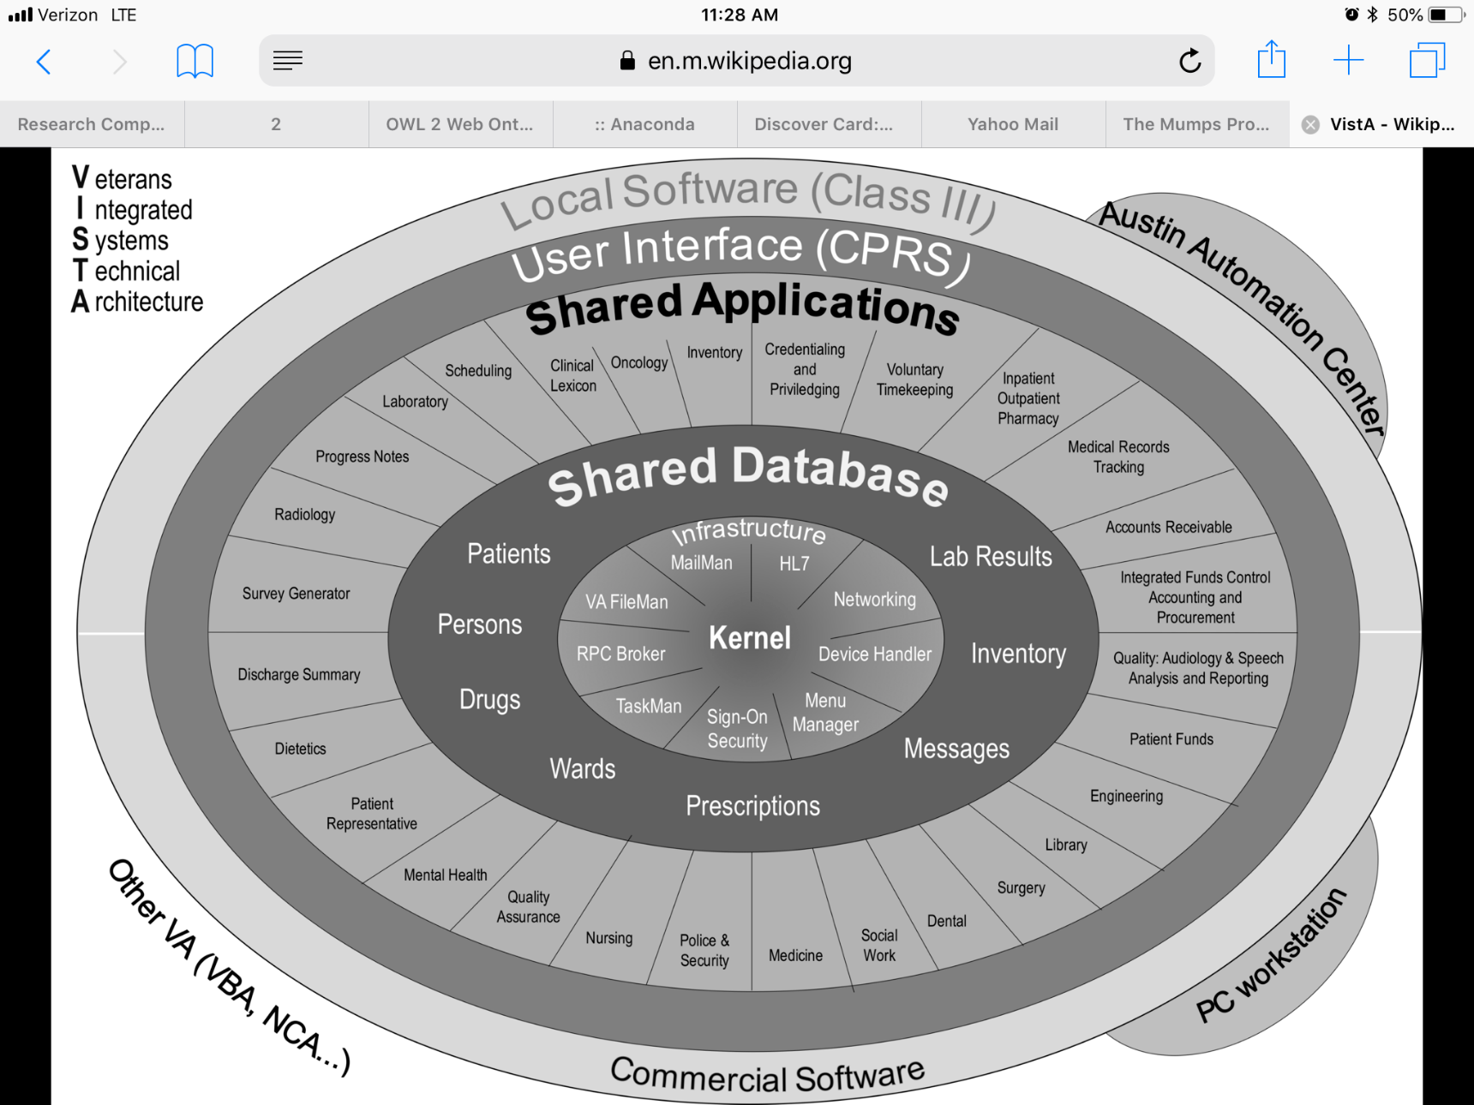

Slide 21
